Slide 1
Brucellosis
Assist. Prof. Dr. Hussein ALNaji

Slide 2
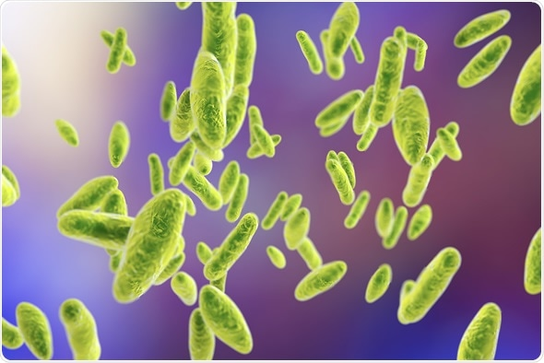
Synonyms: Melitococcosis, undulant fever, Malta fever, Mediterranean fever (in man); contagious abortion, infectious abortion, epizootic abortion (in animals); Bang’s disease (cattle). Etiology: Six species are presently known in the genus Brucella: B. melitensis, B.abortus, B. suis, B. neotomae, B. ovis, and B. canis.

Slide 3
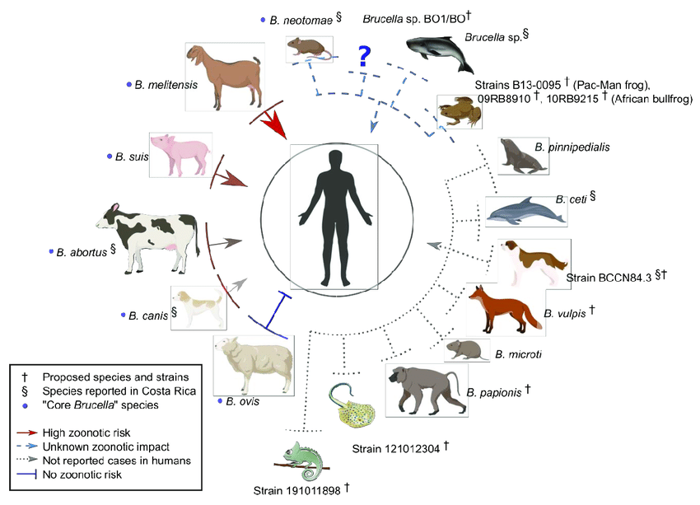

Slide 4
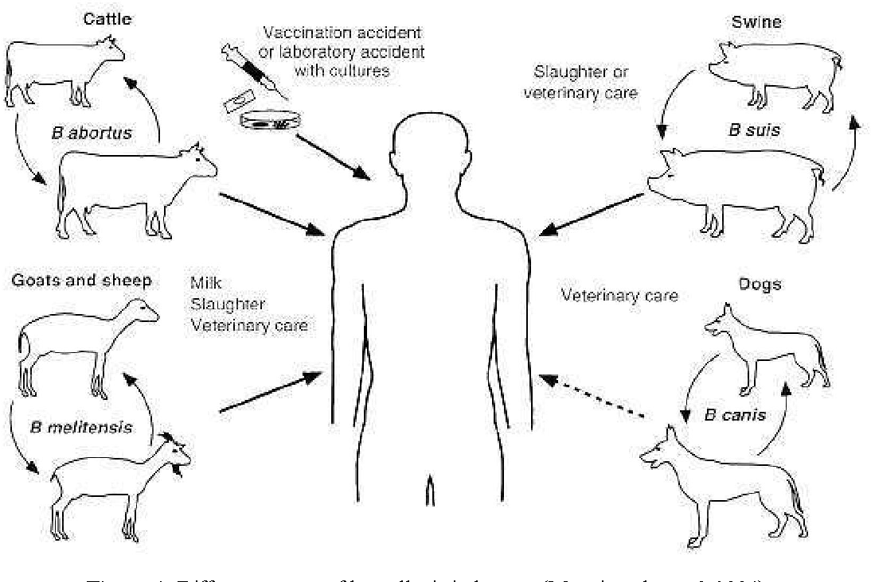
Transmission
1- Eating undercooked meat or consuming unpasteurized/raw dairy products.
2- Breathing in the bacteria that cause brucellosis (inhalation)
This risk is generally greater for people in laboratories that work with the bacteria. In addition, slaughterhouse and meat-packing employees have also been known to be exposed to the bacteria and ultimately become infected.

Slide 5
3- Bacteria entering the body through skin wounds or mucous membranes
Bacteria can also enter wounds in the skin/mucous membranes through contact with infected animals.
This poses a problem for workers who have close contact with animals or animal excretions (newborn animals, fetuses, and excretions that may result from birth). Such workers may include:
1- Slaughterhouse workers
2- Meat-packing plant employees
3- Veterinarians

Slide 6
Symptoms
Brucellosis can cause of range of signs and symptoms, some of which may present for prolonged periods of time.
1- Initial symptoms can include:
Fever, sweats, malaise, anorexia, headache, pain in muscles, joint, and/or back, fatigue
2- Some people have chronic brucellosis and experience symptoms for years, even after treatment. Long-term signs and symptoms may include:
Fatigue, Recurrent fevers, Inflammation of the inner lining of the heart chambers (endocarditis), Joint inflammation (arthritis), Arthritis of the spinal bones (spondylitis), Arthritis of joints where the spine and pelvis connect (sacroiliitis)

Slide 7
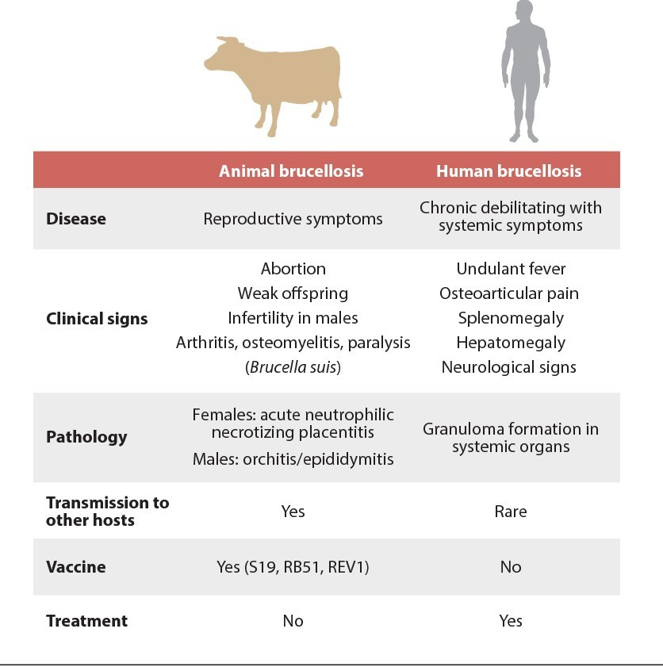

Slide 8
Prevention
1- The best way to prevent brucellosis infection is to be sure you do not consume: undercooked meat, unpasteurized dairy products, including: milk, cheese, ice cream
Pasteurization is when raw milk is heated to a high temperature for a short period of time. This heating process destroys harmful bacteria that may make the milk unsafe to consume.
2- People who handle animal tissues (such as hunters and animal herdsman) should protect themselves by using: rubber gloves,goggles
gowns or aprons

Slide 9
Thank you

